Slide 1
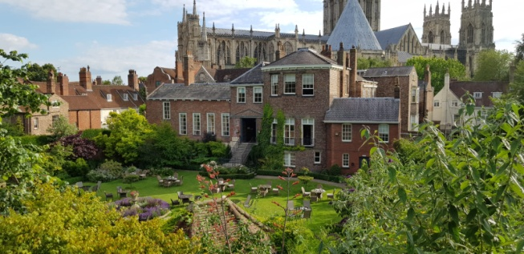
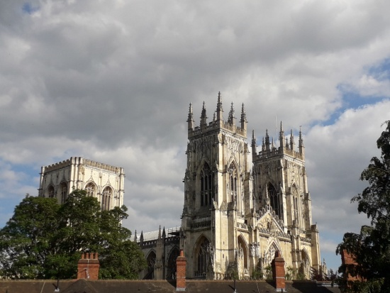
ERASMUS +
ITAS “TOSI” Codogno
YORKERS FOR A WHILE
Zuccotti Katia
Bernocchi Barbara
Sudati Antonella
Bassini Silvia

Slide 2
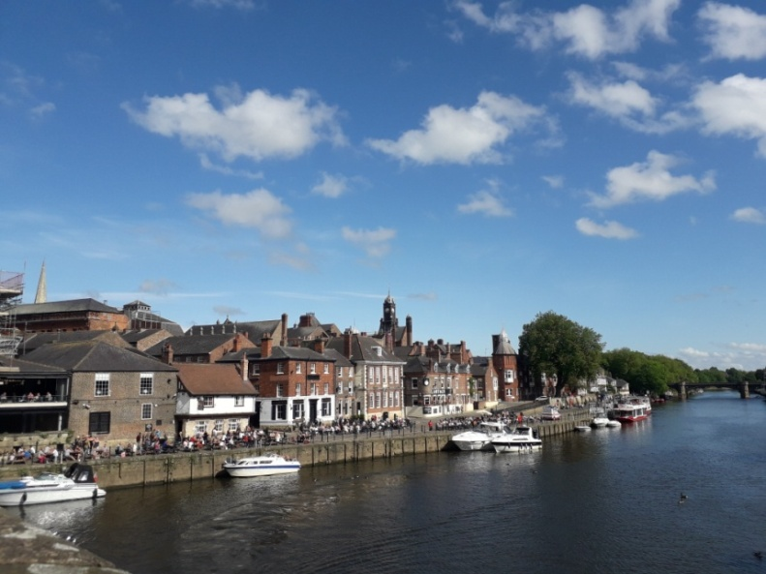
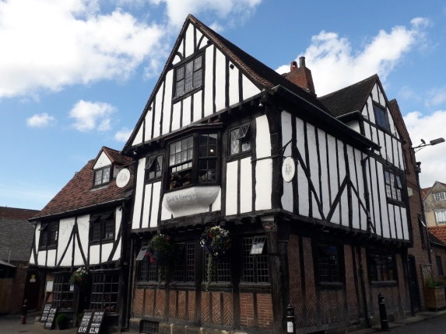
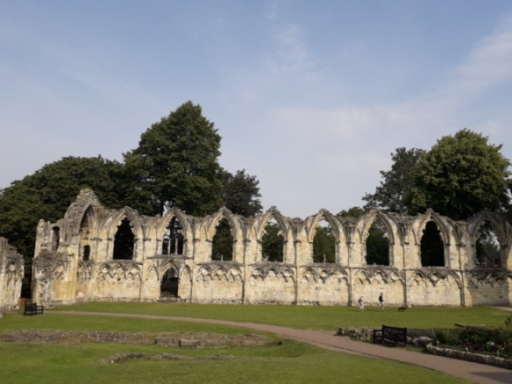
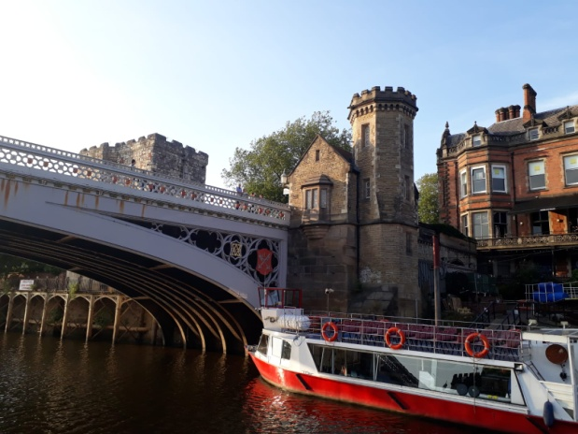
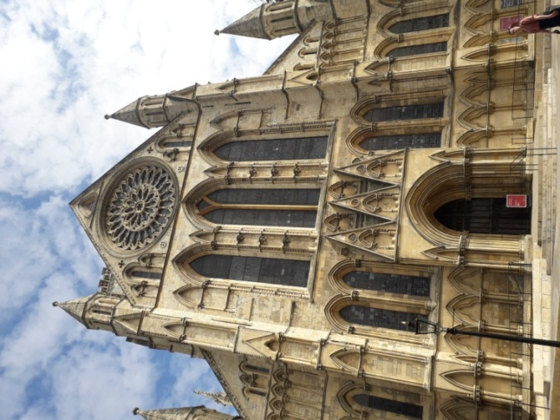
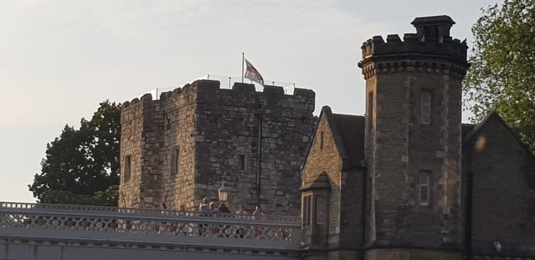
YORK AT A GLANCE

Slide 3
YORK ASSOCIATES SCHOOL JULY 2019
Zuccotti Katia, “Emotional Intelligence in the Teaching Environment”(15-19 July)
Bassini Silvia “Emotional Intelligence in the Teaching Environment”(15-19 July)
Bernocchi Barbara “Fluency and English Language Development for Teachers” (15-19 July)
Sudati Antonella “Fluency and English Language Development for Teachers”, (15-26 July)

Slide 4
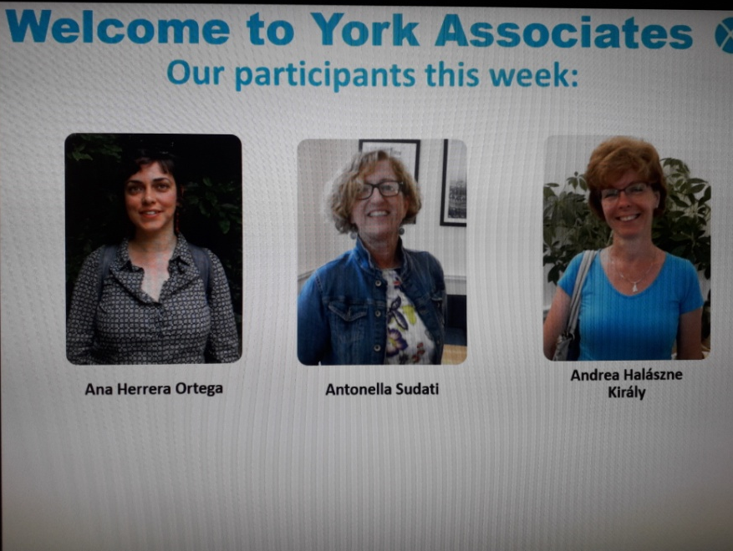

Slide 5
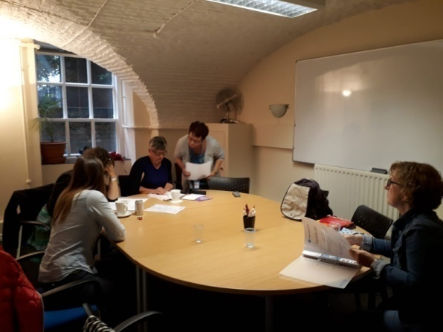
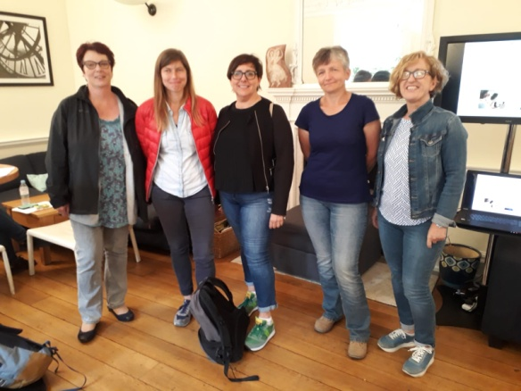
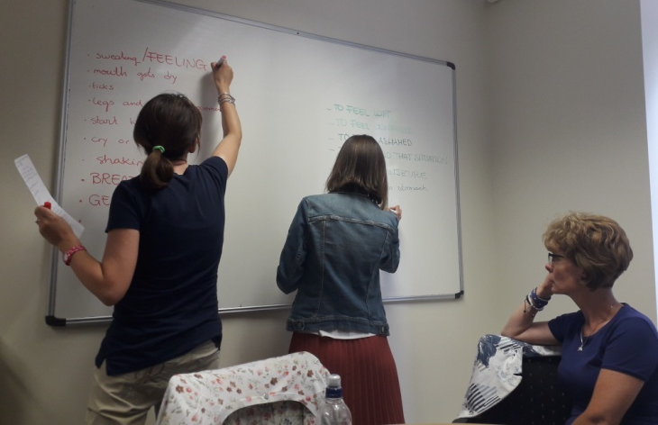
MEETING COLLEGUES FROM OTHER EUROPEAN COUNTRIES
SHARING EXPERIENCES
LIVING BRITISH CULTURE
UPDATING TEACHING TECHNIQUES

Slide 6
EMOTIONAL INTELLINCE IN THE TEACHING ENVIRONMENT: WEEKLY TIMETABLE
MON | TUE | WED | THU | FRI
12.30-17.30 | 12.30-17.30 | 12.30-17.30 | 12.30-17.30 | 9.00-11.00
COURSE OBJECTIVES:
Focusing on the emotional side of learning
Learning new teaching strategies
Sharing ideas
boosting social and life skills

Slide 7
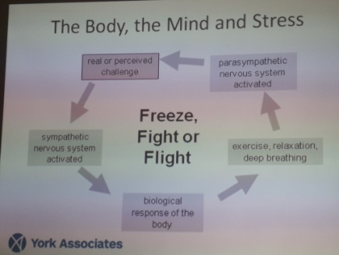
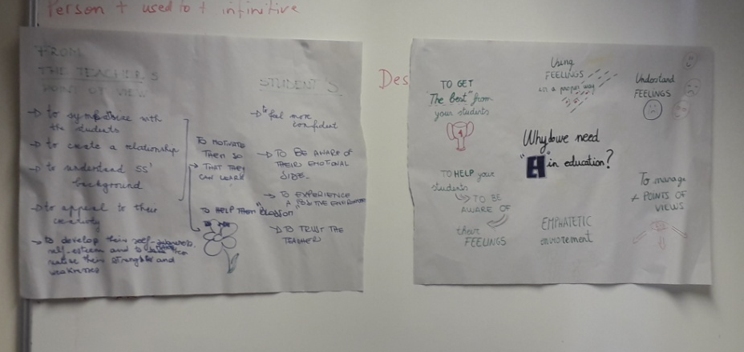
A TYPICAL DAY: MAIN ACTIVITIES
LEARNING ABOUT EMOTIONAL INTELLIGENCE
PAIR OR GROUP ACTIVITIES
PLANNING LESSONS/ACTIVITIES
LEARNING HOW TO APPEAL TO AND EXPLOIT EMOTIONAL INTELLIGENCE TO CREATE A FRUITFUL LEARNING ENVIRONMENT

Slide 8
FLUENCY AND ENGLISH LANGUAGE DEVELOPMENT FOR TEACHERS
MONDAY | TUESDAY | WEDNESDAY | THURSDAY | FRIDAY
9.00-12.00 | 9.00-12.00 | 9.00-12.00 | 9.00-12.00 | 9.00-12.00
13.00-15.00 | 13.00-15.00 | 13.00-15.00 | 13.00-15.00 | 13.00-15.00
COURSE OBJECTIVES:
BOOSTING ENGLISH LANGUAGE
FOCUSING ON COMMUNICATION AND SPEAKING SKILLS
LEARNING MOTIVATING TEACHING STRATEGIES

Slide 9
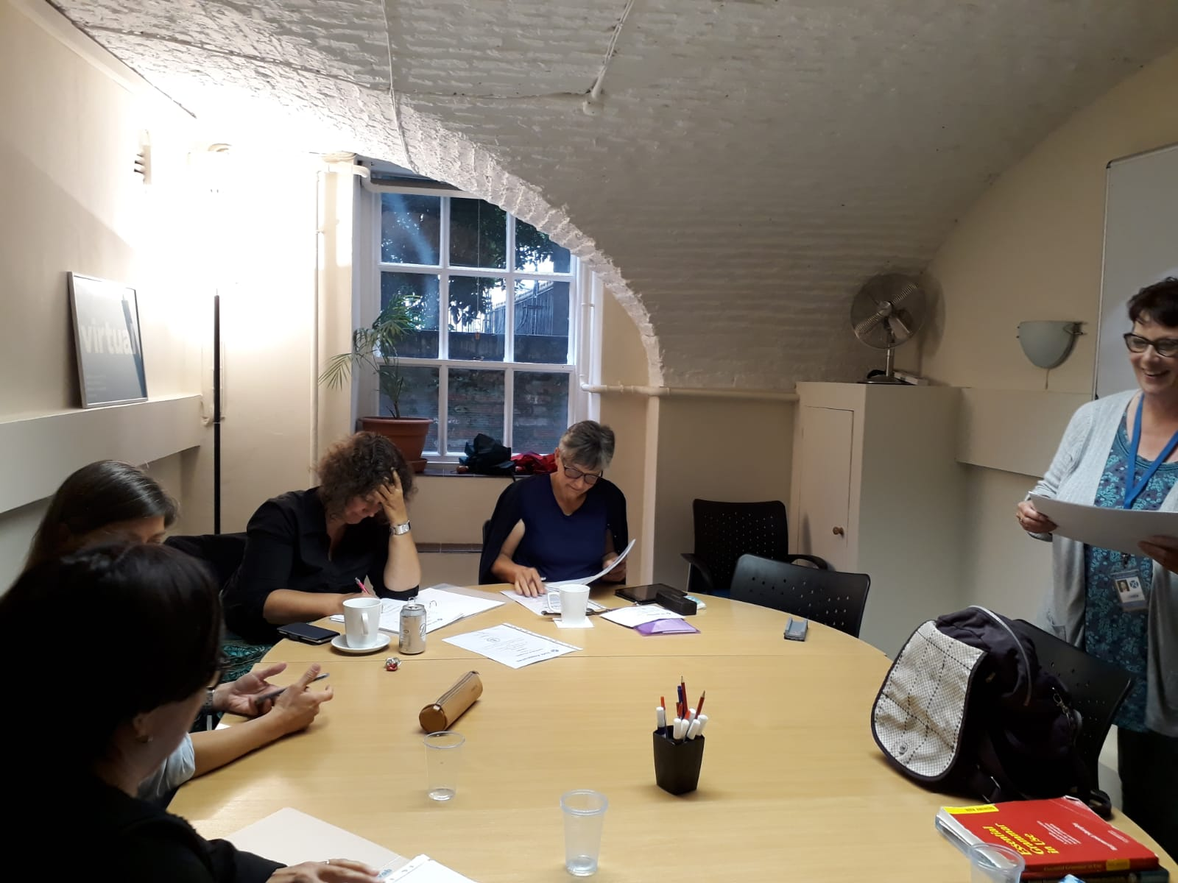
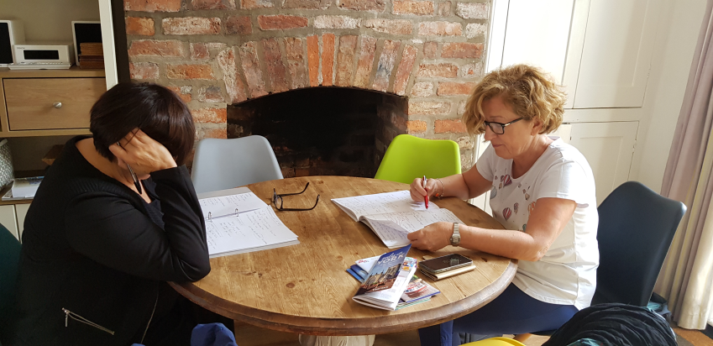
A TYPICAL DAY: MAIN ACTIVITIES
LANGUAGE EXERCISES
PROJECT ACTIVITIES
PUBBLIC SPEAKING TECHNIQUES: INTRODUCING A TOPIC
CONVERSATION
LEARNING ABOUT CULTURE

Slide 10
TO PUT IT IN A NUTSHELL ERASMUS+ HAS BEEN…
OVERCOMING YOUR ROUTINE COMFORT ZONE
REALIZING THAT THERE SOME EXPERIENCES GO
BEYOND YOUR EXPECTATIONS
CHANGING PERSPECTIVE IS INDEED
THE PATH TO OPENMINDEDNESS

Slide 11
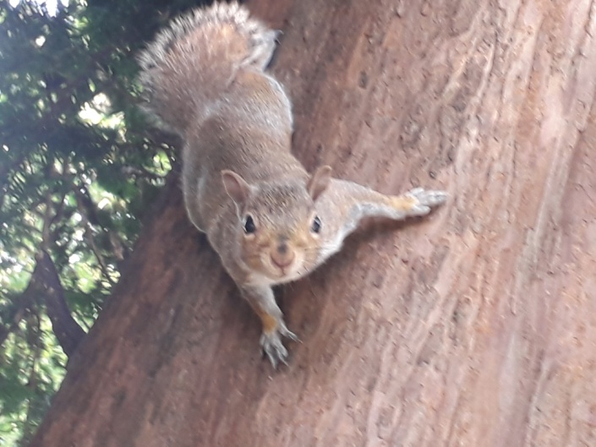
GREETINGS FROM YORK!!!

