Slide 1
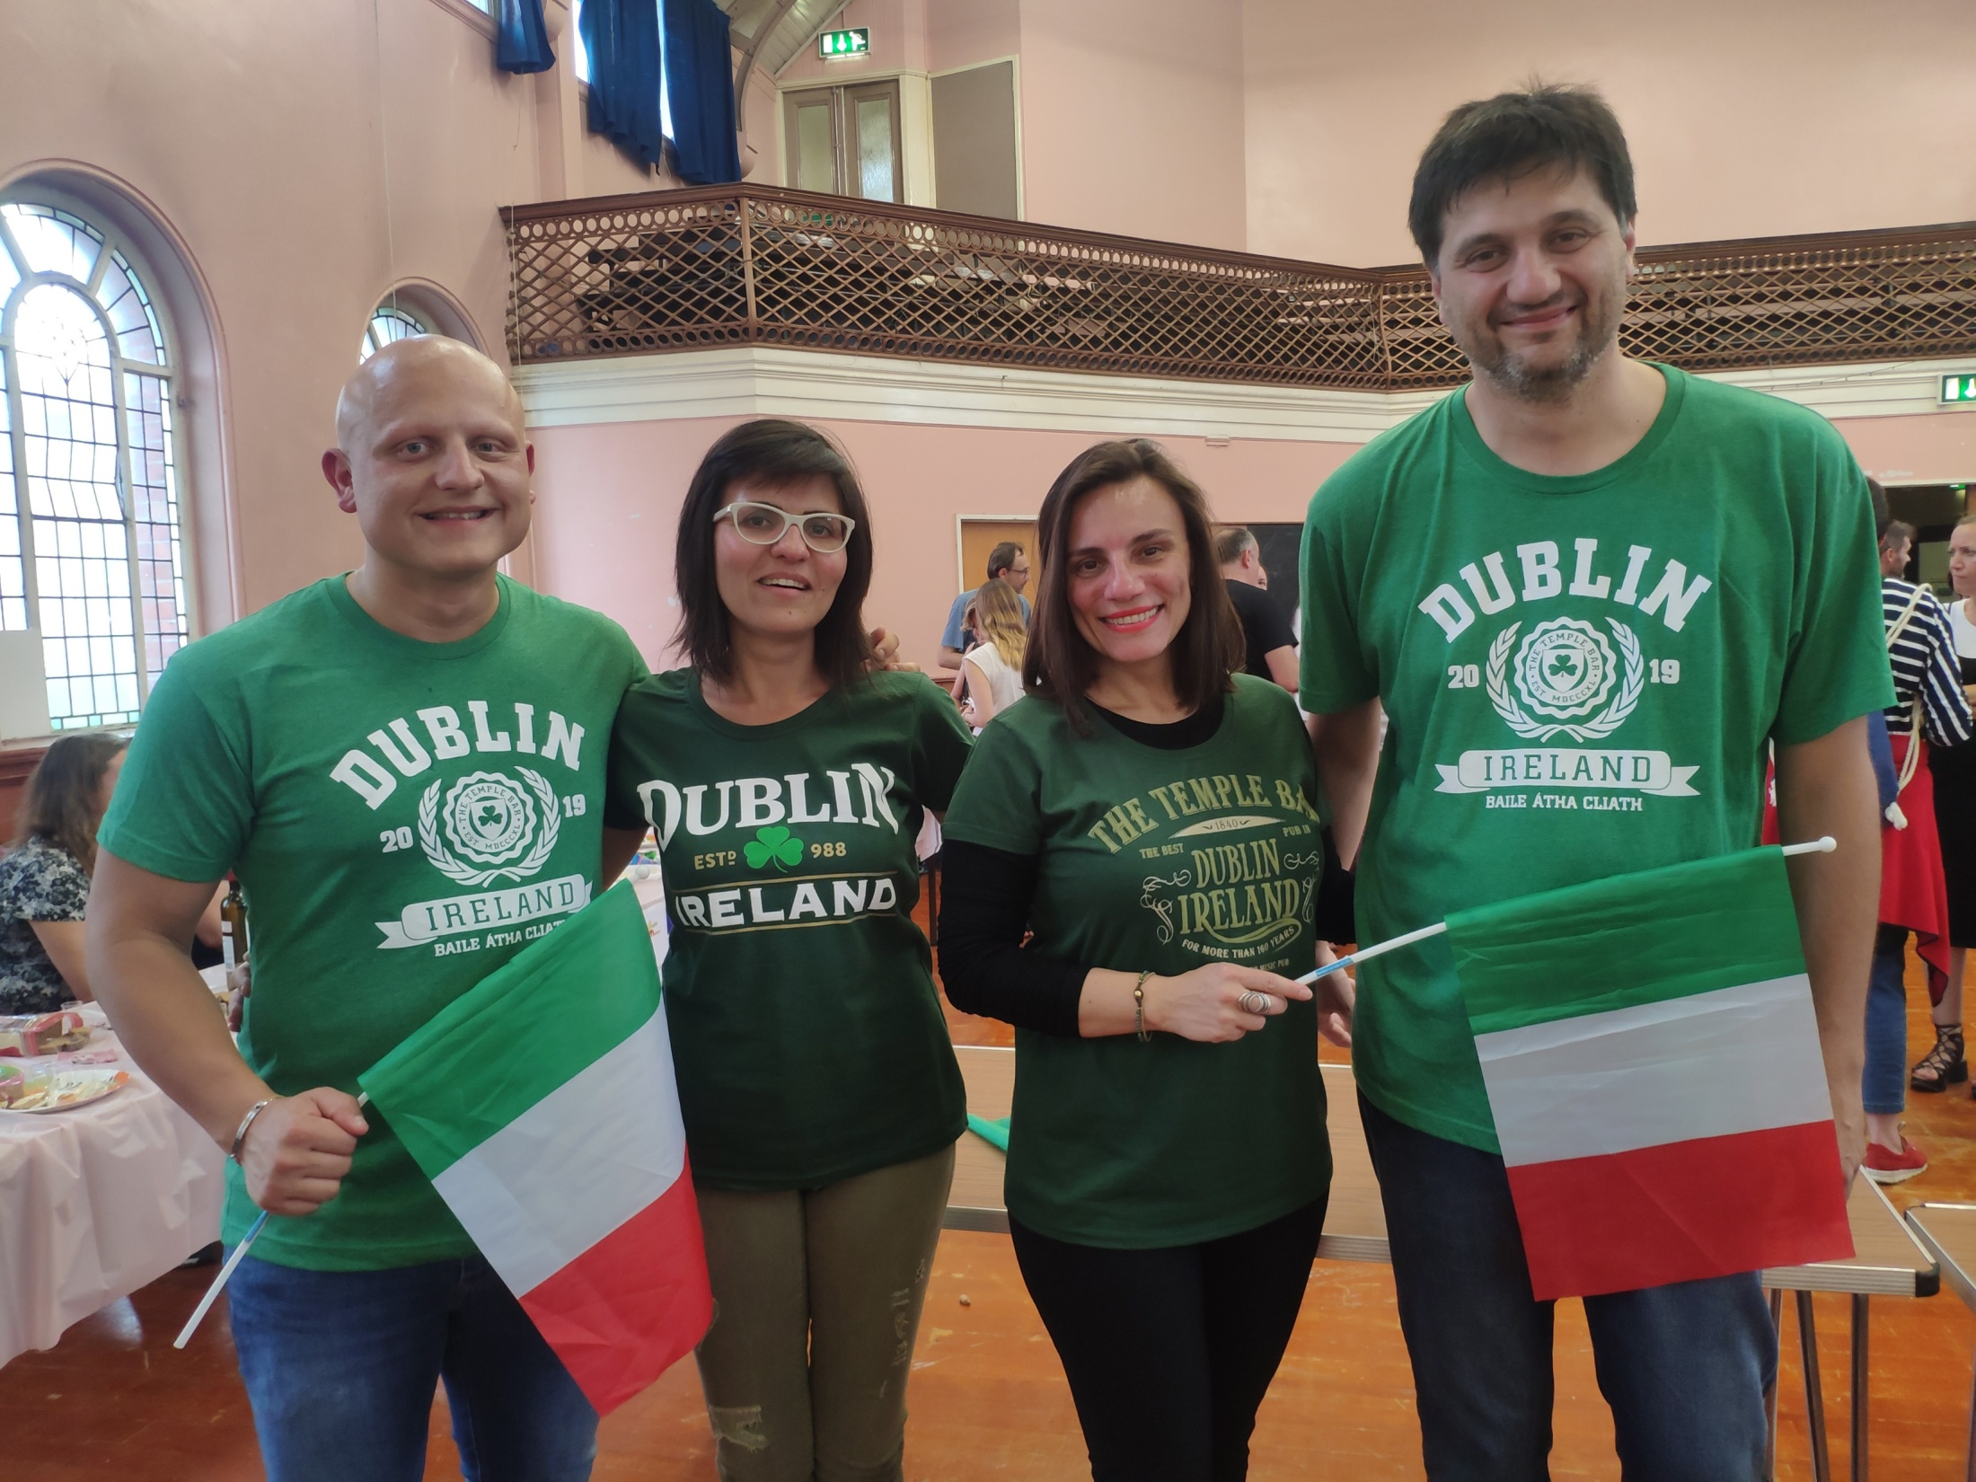
Erasmus plus
Study and fun

Slide 2
Trinity College (Dublin) 22 July – 2 August 2019 English for teachers level A2/B1
WHAT WE LEARNED
Vocabulary and grammar
2. Irish culture
3. Teaching methodologies

Slide 3
Vocabulary and grammar
Vocabulary
Present simple and present continuous
Past simple, present perfect
Affirmative, negative and questions
Tricky sentences (with «like» for example)
Countable and uncountable nouns
Conditional sentences
Questions (what/who/where/when/how)

Slide 4
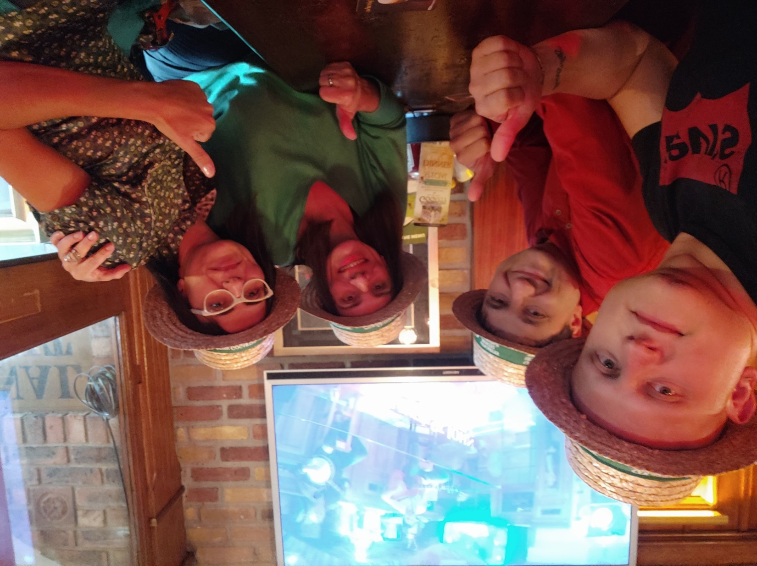
Irish culture
Discovery of Dublin
Food and pub culture
History
Traditions
Irish slang
Music & dance
Legends
Sports and hobbies
Stereotype

Slide 5
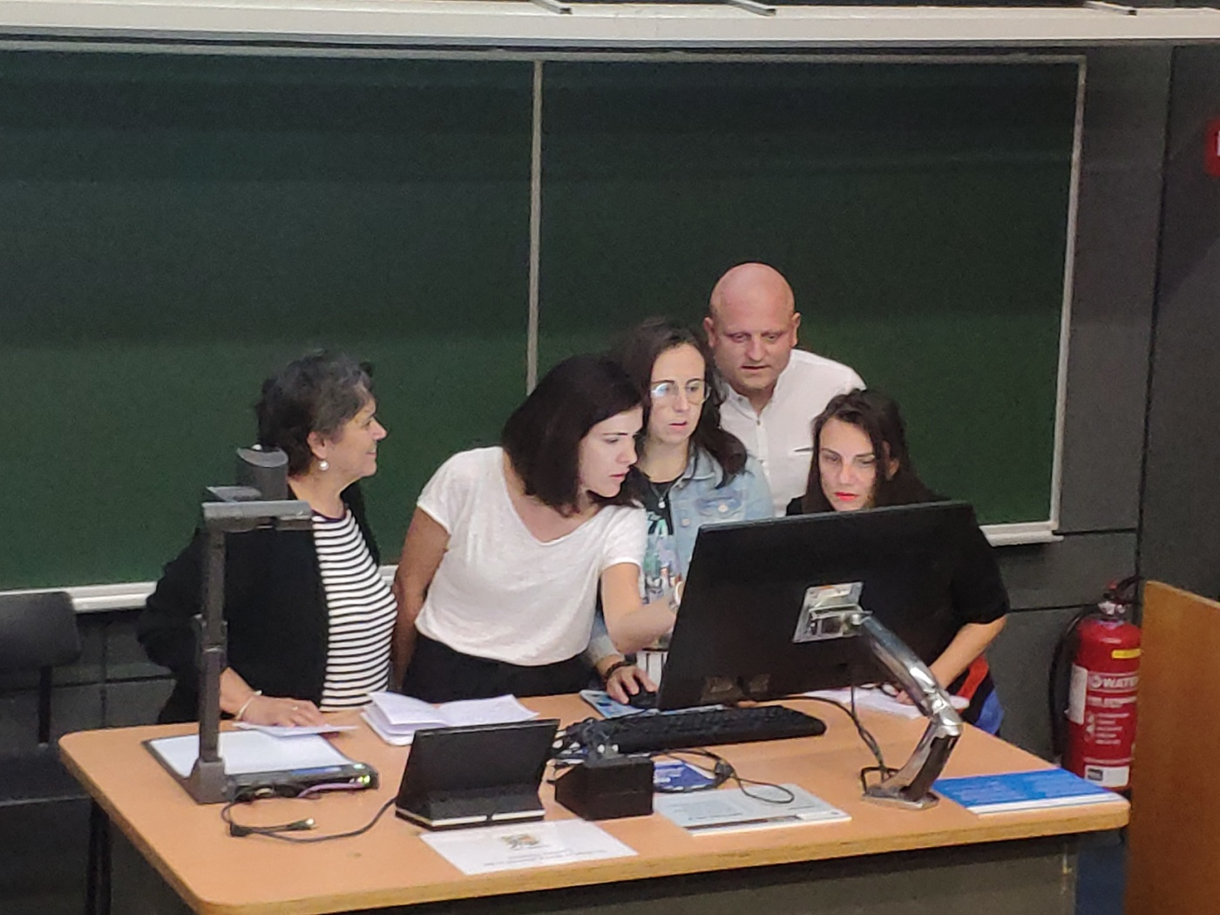
Teaching methodologies
Conversation, dialogues, interviews
Comprehension
Team working
Debate
Task field based project
Role Playing
Cooperative learning
Reality simulations
Orientiring (to learn about the city and socialize)

Slide 6
Ireland 22 July – 3 August 2019
WHAT WE SAW
Dublin
2. Belfast
3. Giant causeway

Slide 7
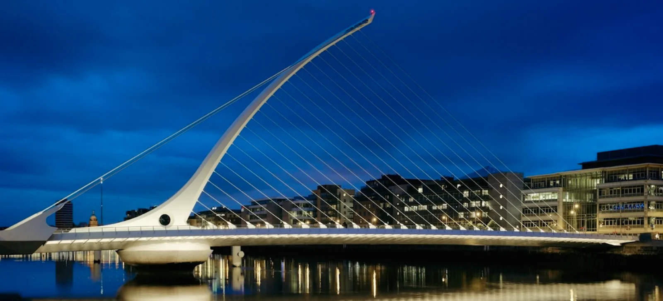
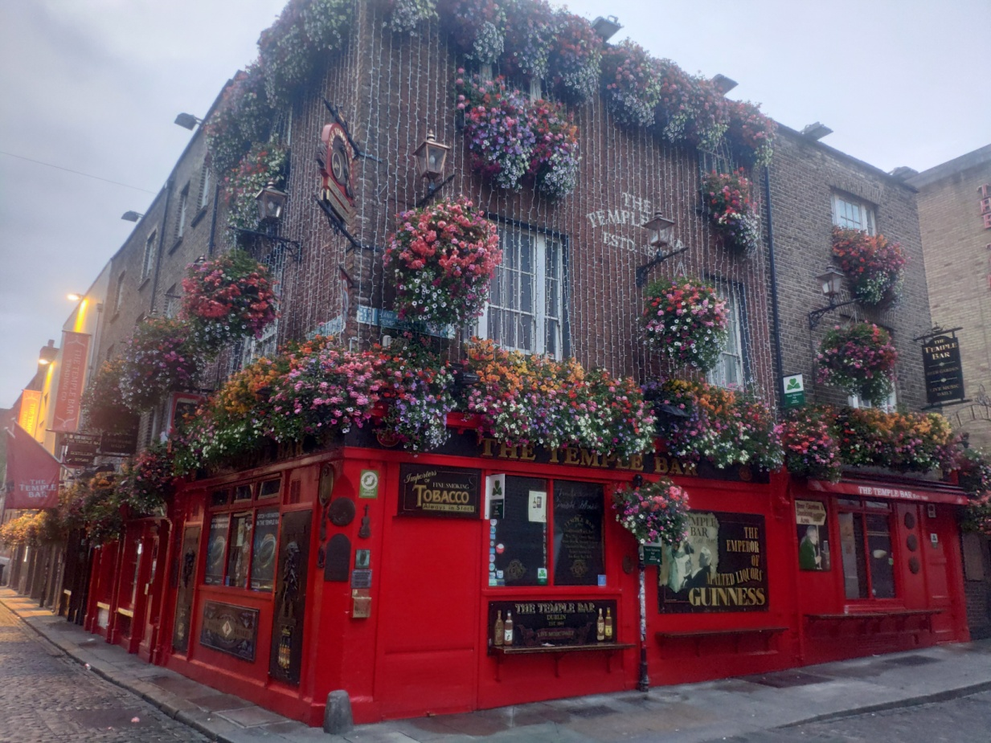
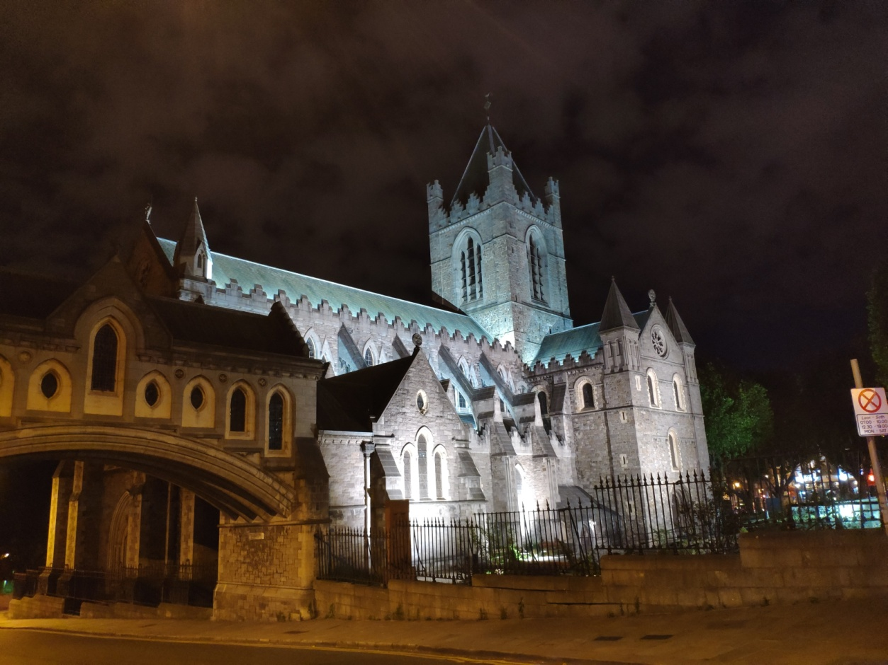
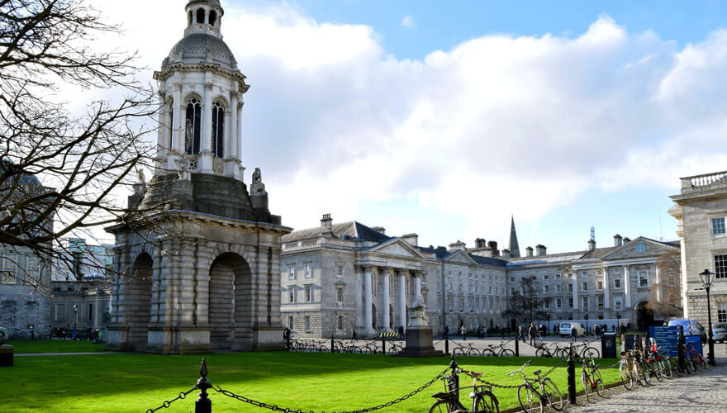
Liﬀey river, Calatrava’s bridge
Temple Bar
Dublin
Trinity College
Christ Church Cathedral

Slide 8
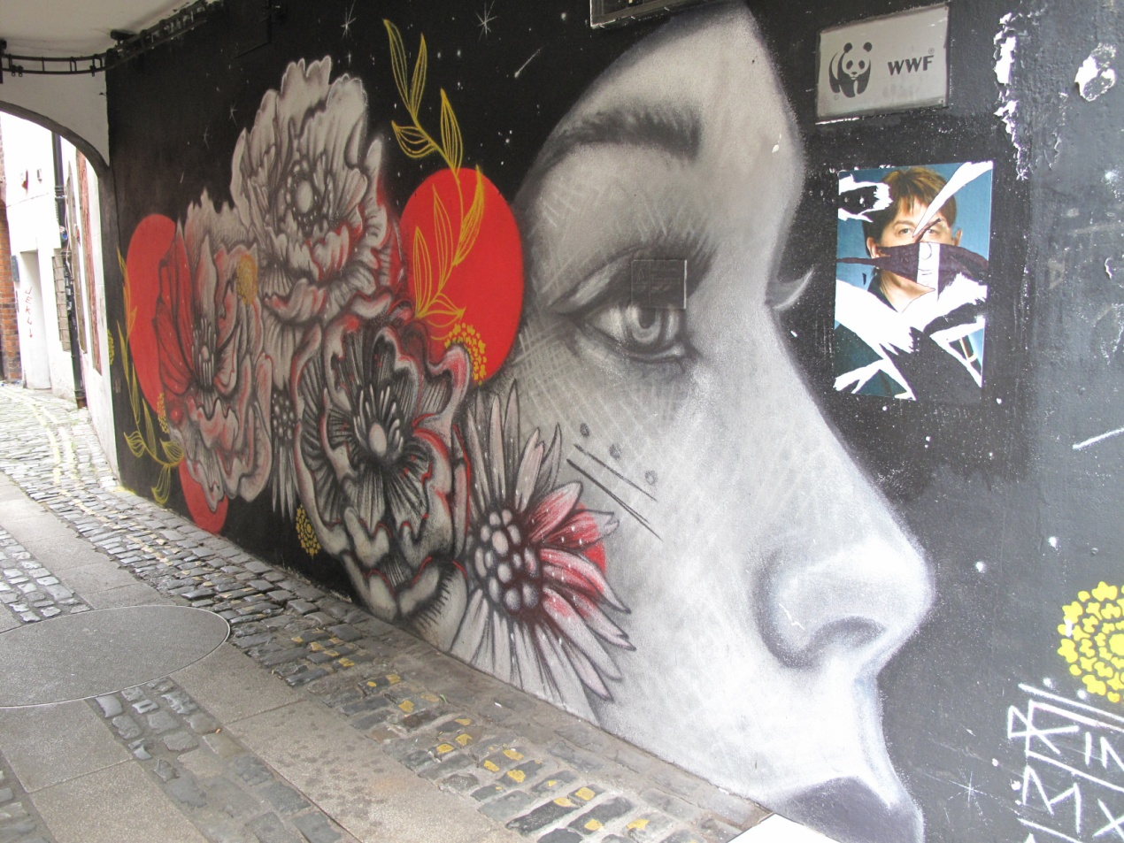
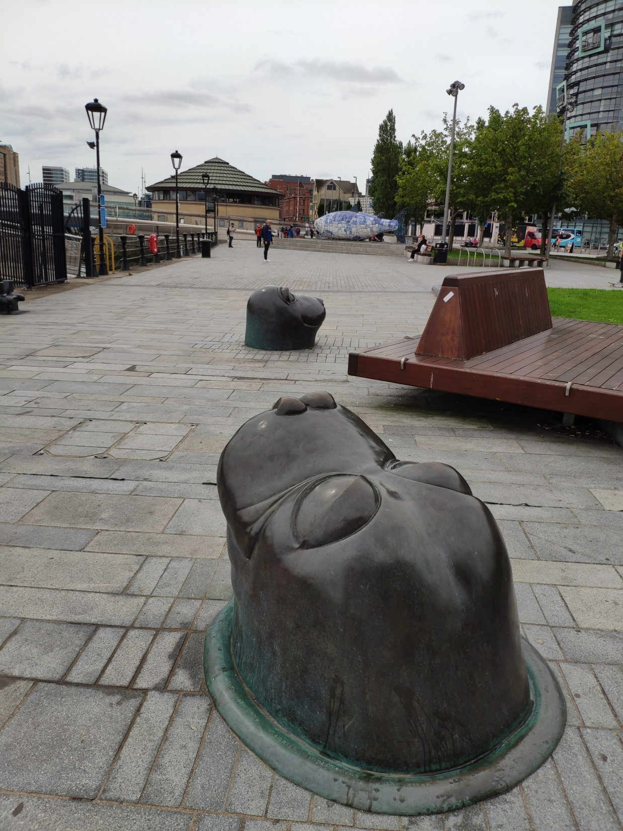
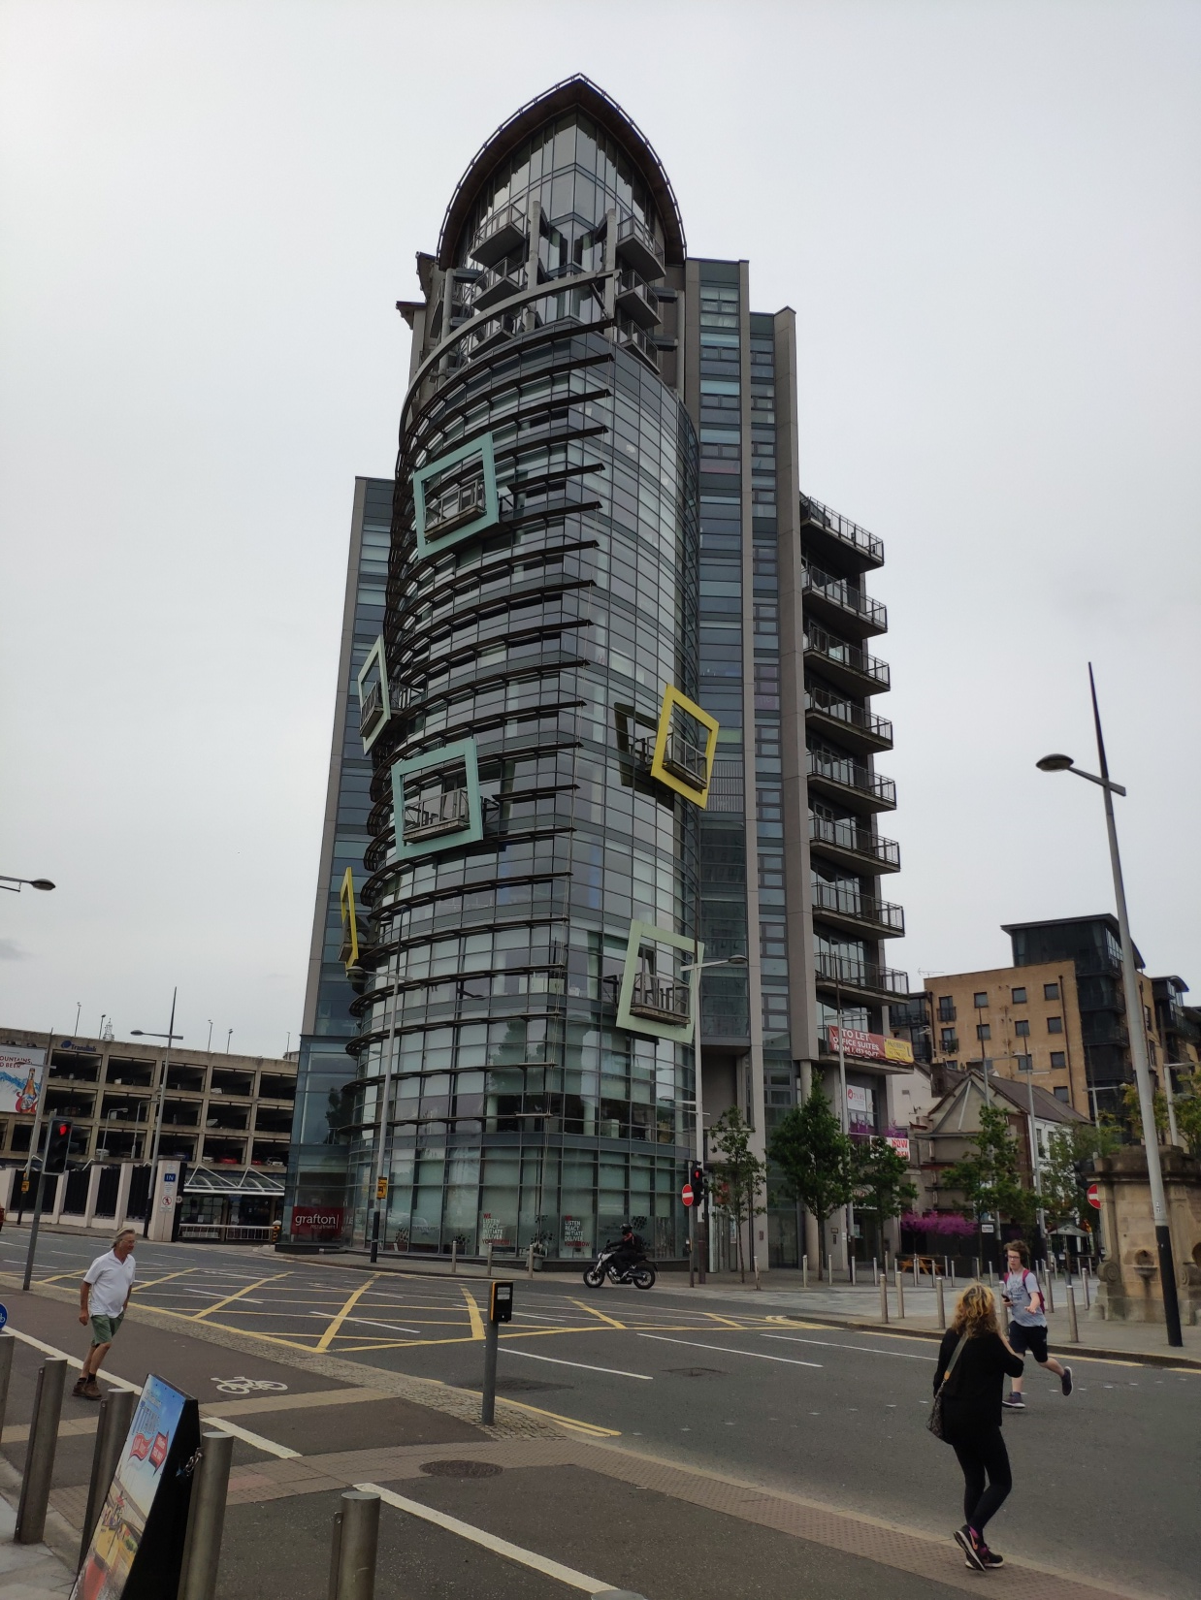
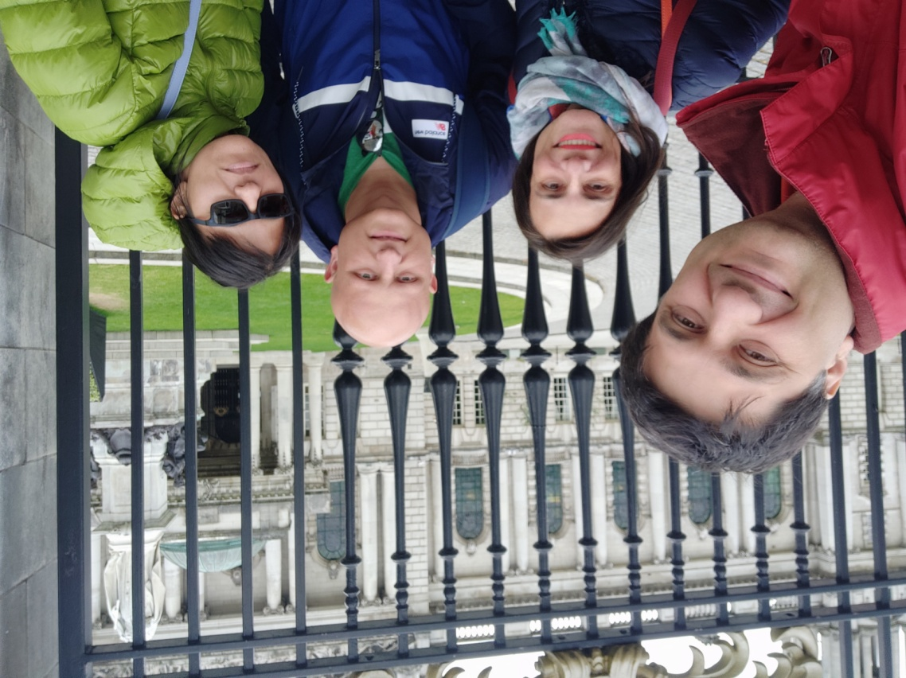
The port
The murals
Belfast
City hall

Slide 9
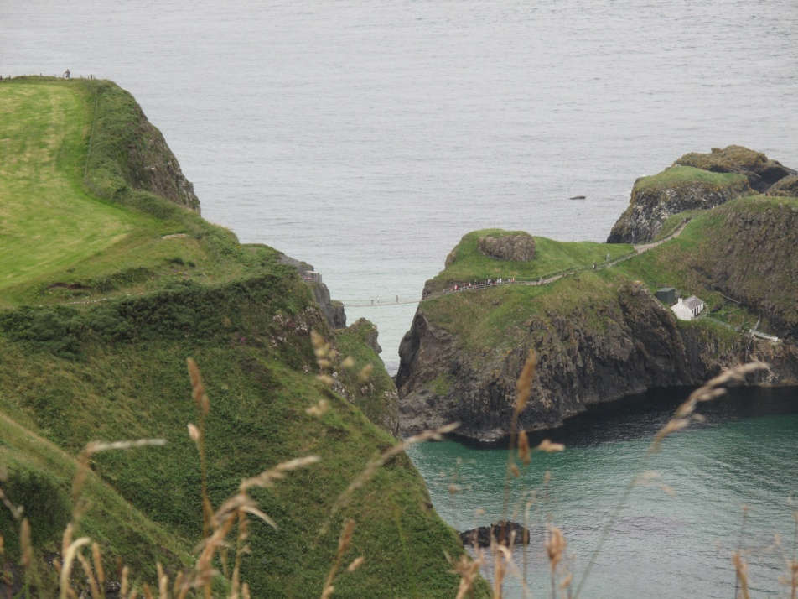
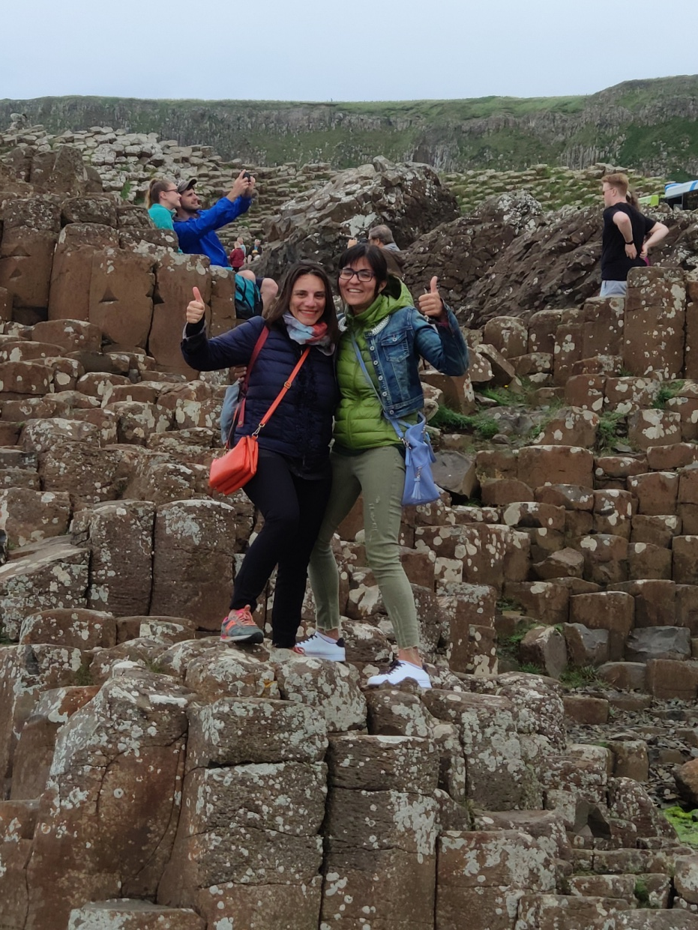
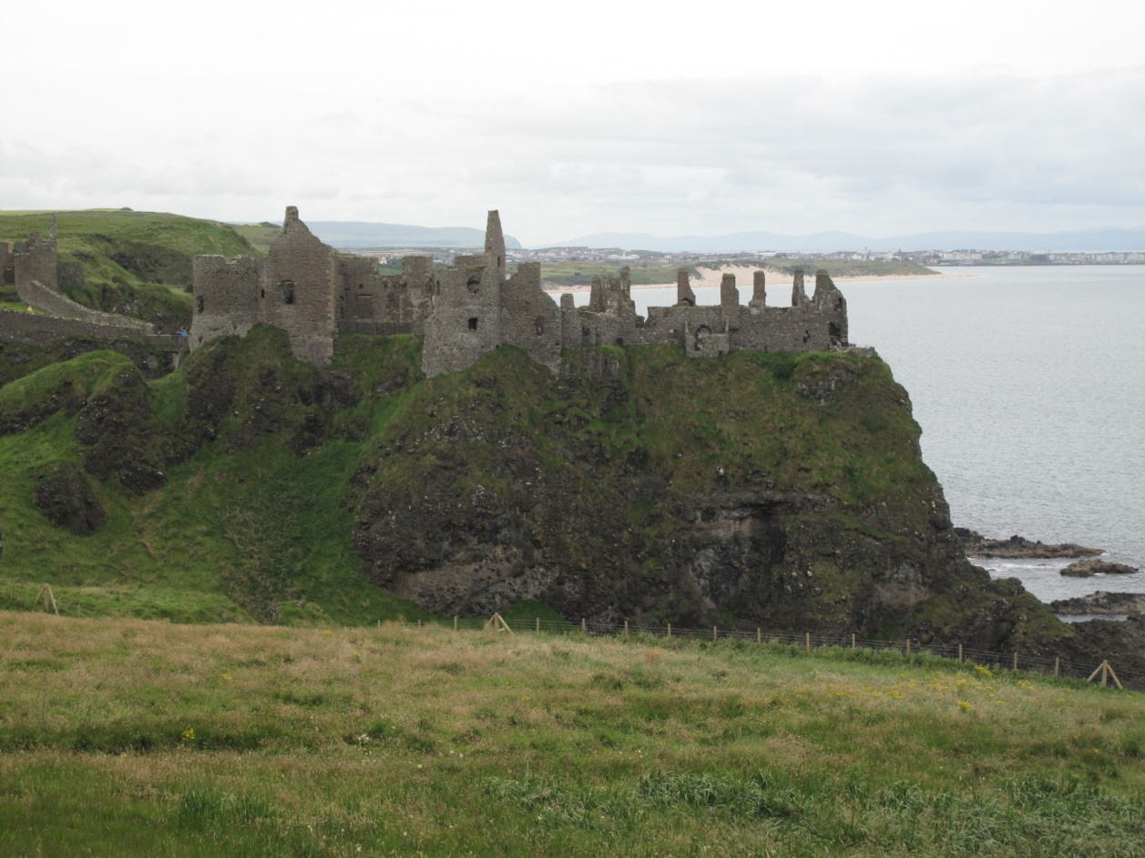
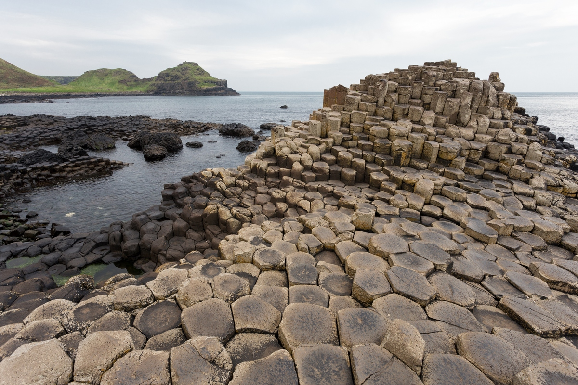
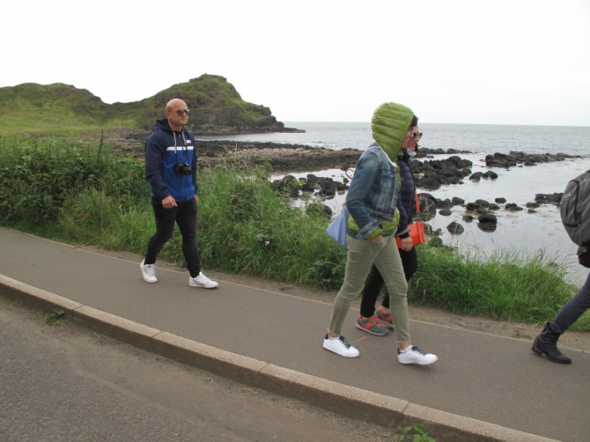
Giant causeway

Slide 10
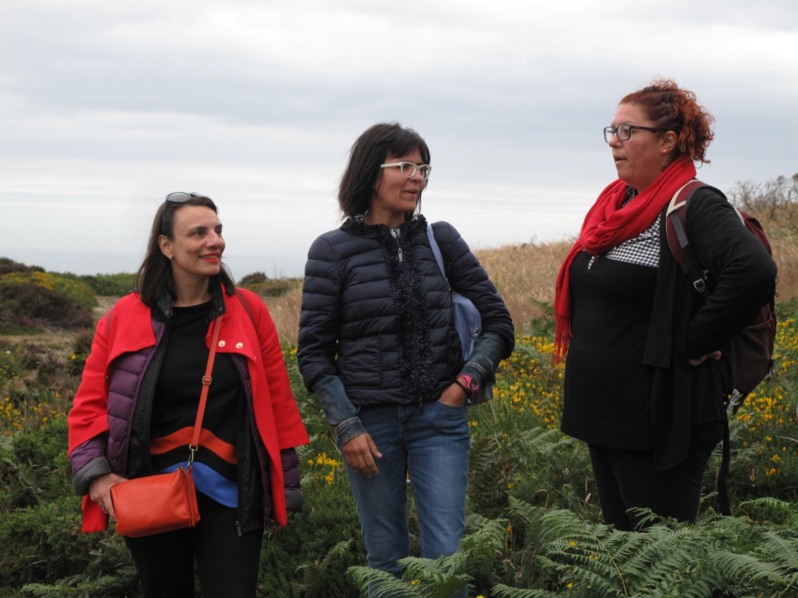
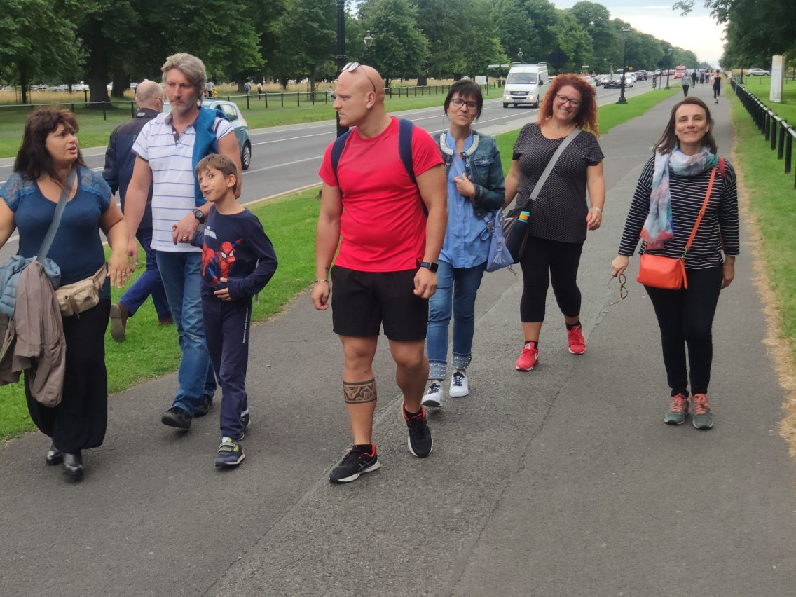
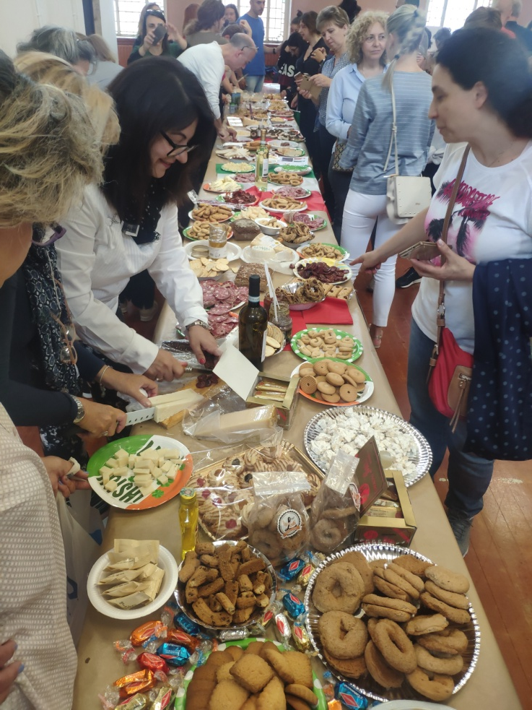
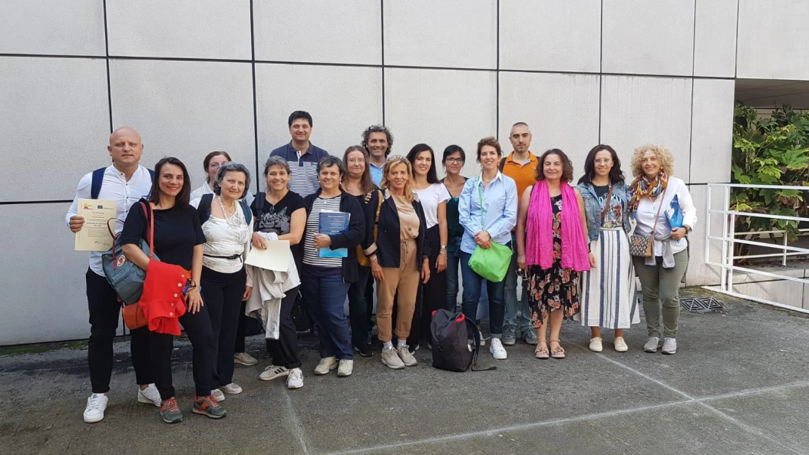
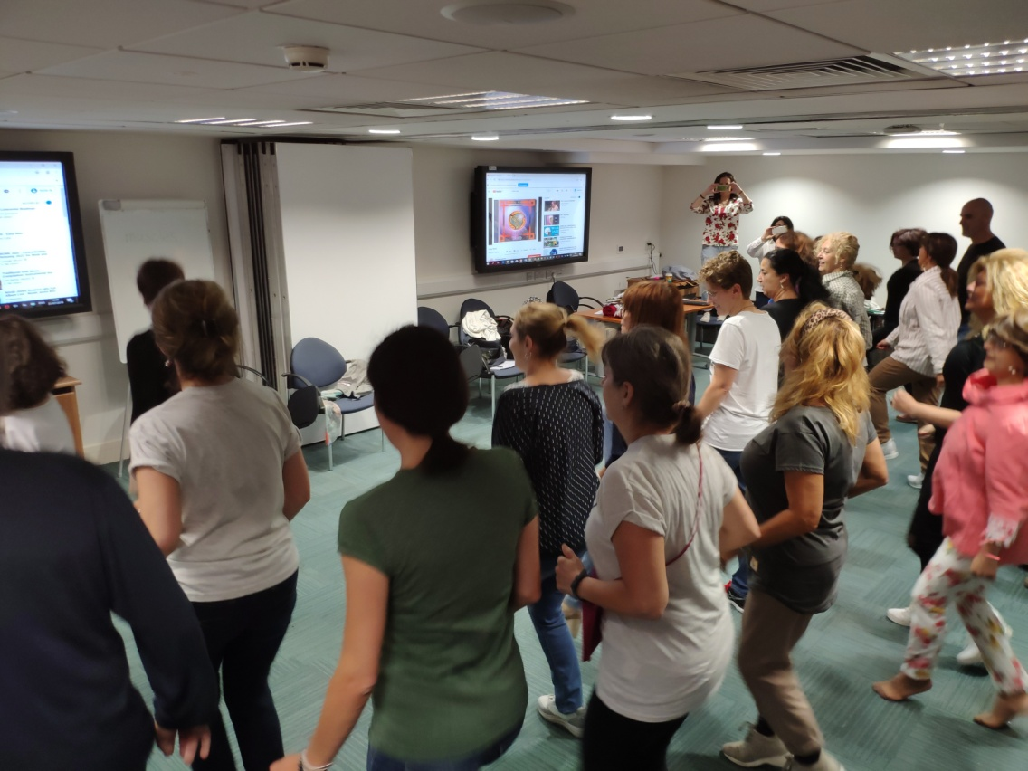
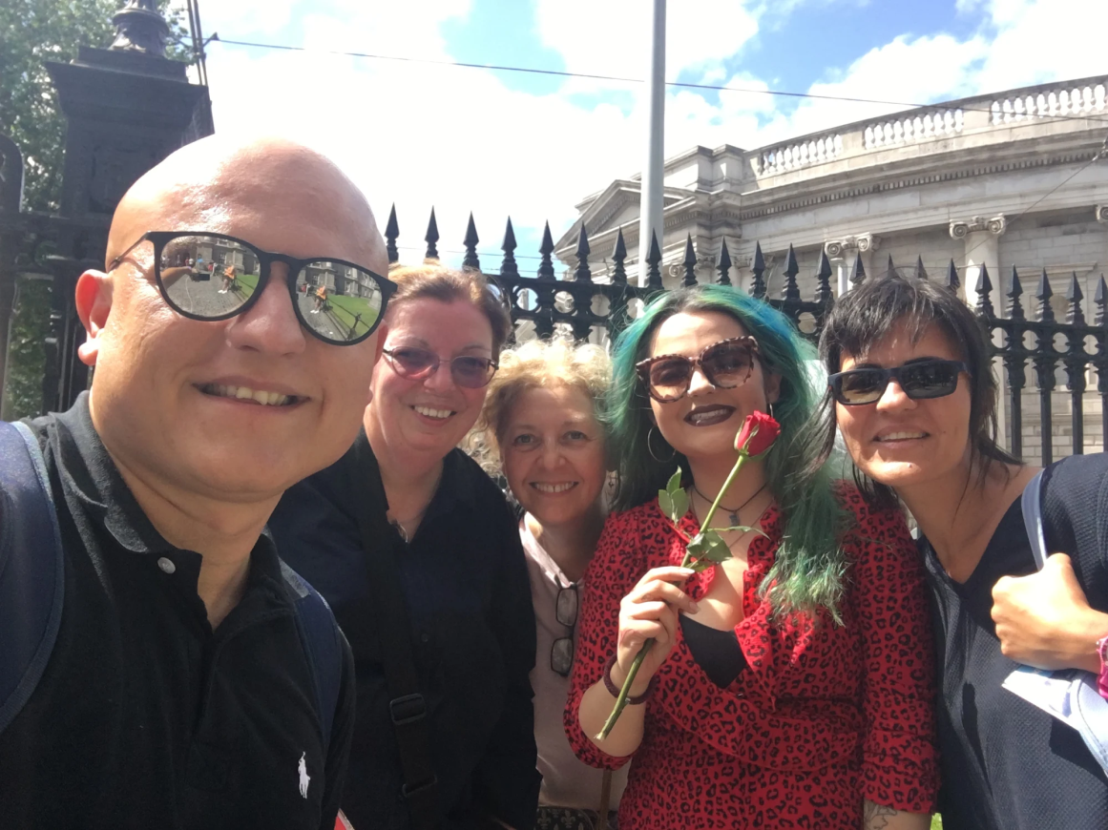
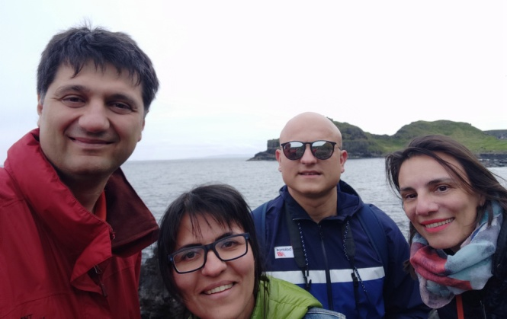
and friendship!!

Slide 11
Massimo De Cecco
Orlando Renda
Iolanda Cimmino
Paola Tataranno

