Slide 1
ERASMUS+ 2019
COURSES
ACTIVATE YOUR ENGLISH FOR TEACHING
ICT FOR TEACHING
DUBLIN, 22th JULY – 3rd AUGUST 2019

Slide 2
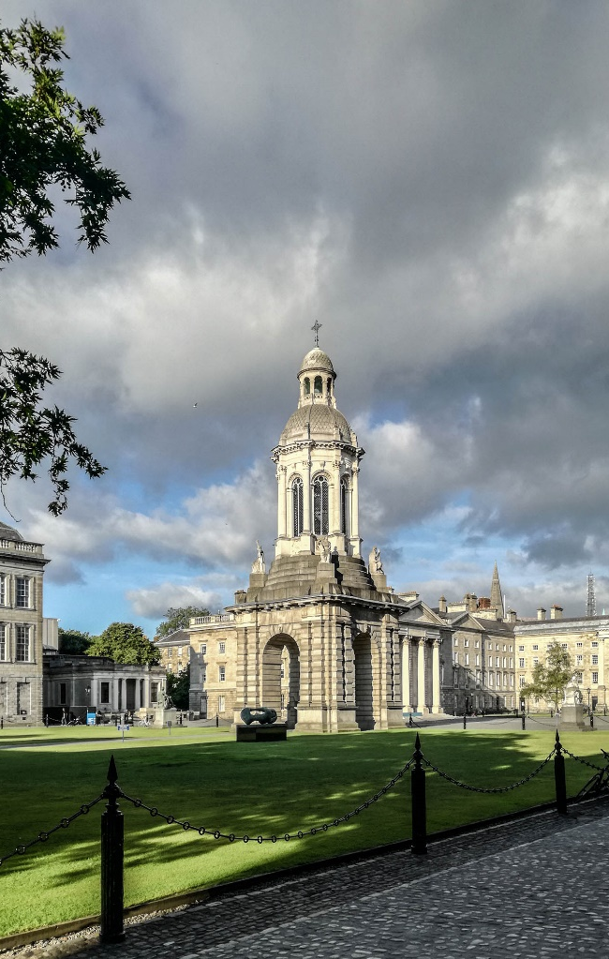
DAILY ROUTINE
8:00 – Breakfast
9:00 – 12:30 English lessons
12:30 – 13:30 Lunch
13:30 – 15:00 English lessons or task-based field projects/ building our Portfolio
15:30 – 16:30 Task-based projects, autonomous work on learning Portfolio
18:00 – 21:00 Dinner and spare time

Slide 3
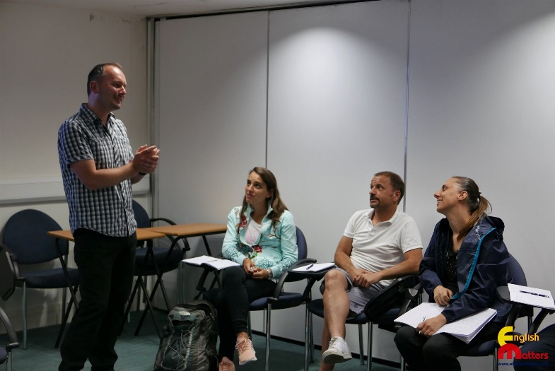
METHODOLOGIES
ICT Tools for image and sound editing
ICT Tools for collaboration using social Media
ICT Tools for narratives of learning digital stories using image, text and music
ICT Tools for creating webpages, blogs and podcasts
ICT Tools for classroom management and self assessment
Game for Teaching
Cooperative Learning
Role play
Treasure hunt
Quiz

Slide 4
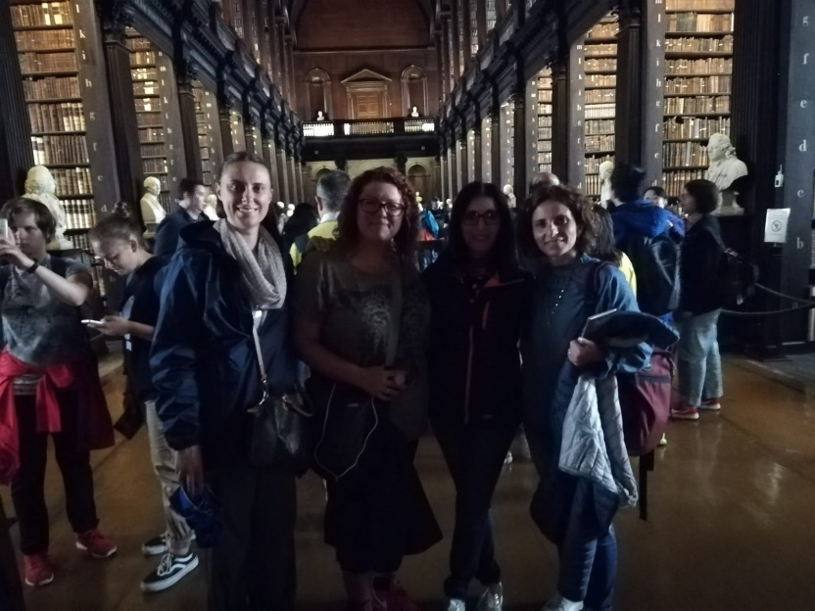
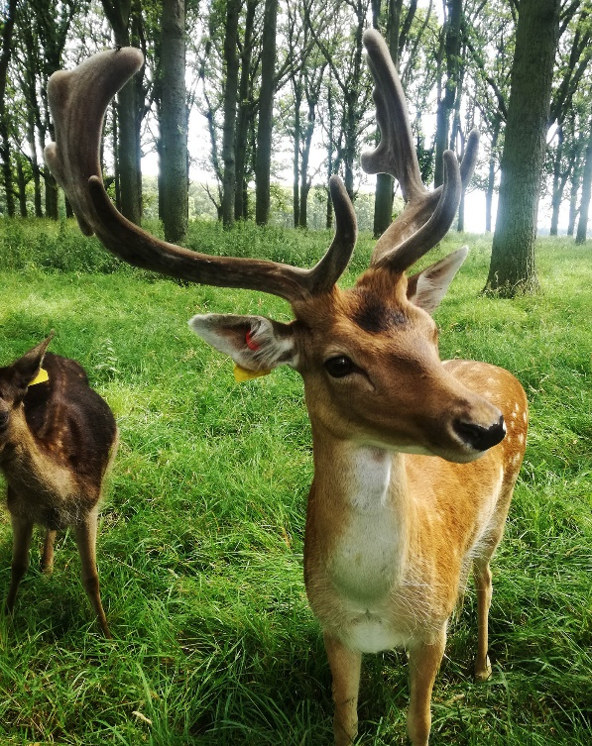
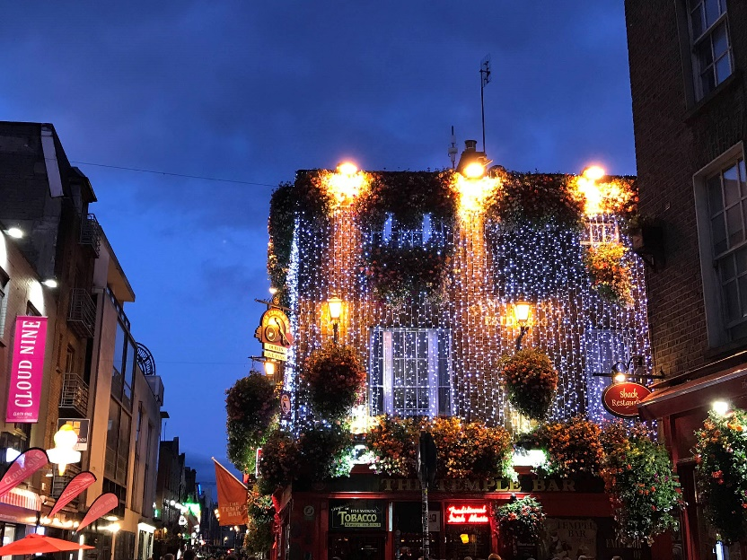
DISCOVERING DUBLIN
THE BOOK OF KELLS
THE TEMPLE BAR
THE PHOENIX PARK

Slide 5
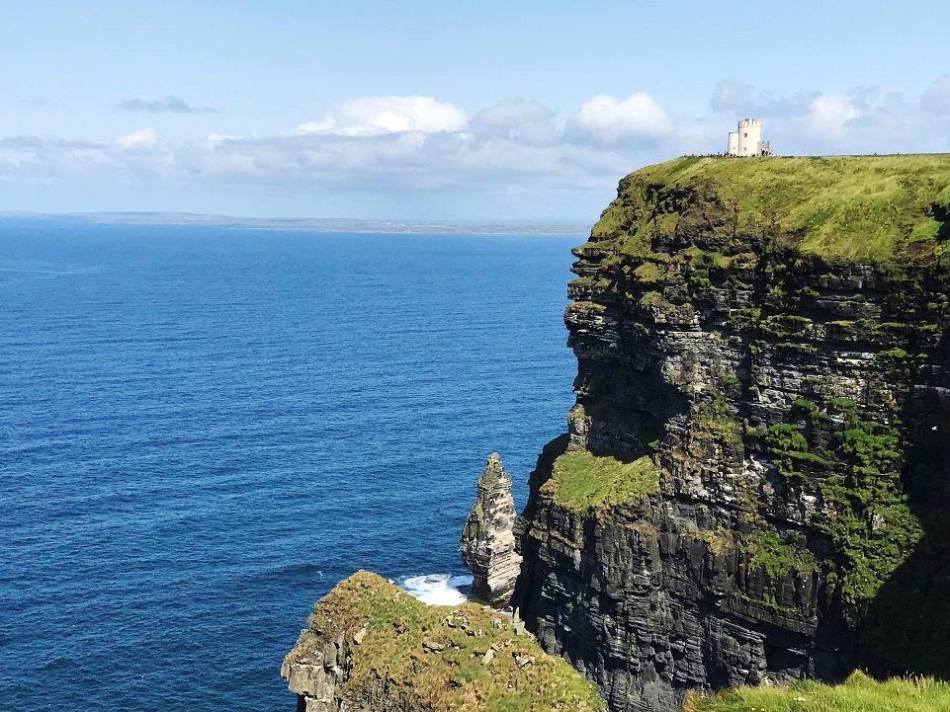
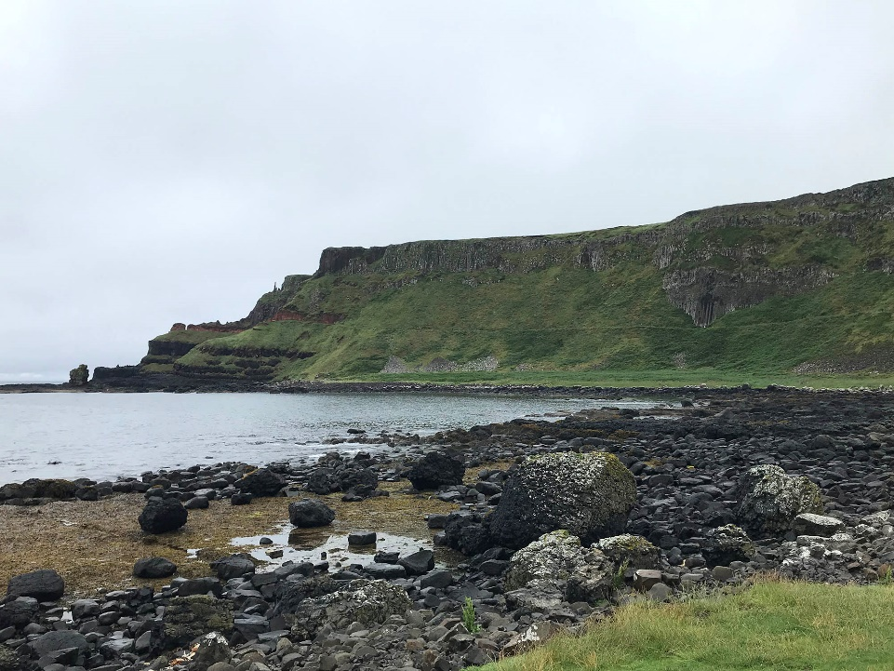
DUBLIN’S SURROUNDINGS
MOHER CLIFFS
GIANT’S CAUSEWAY

Slide 6
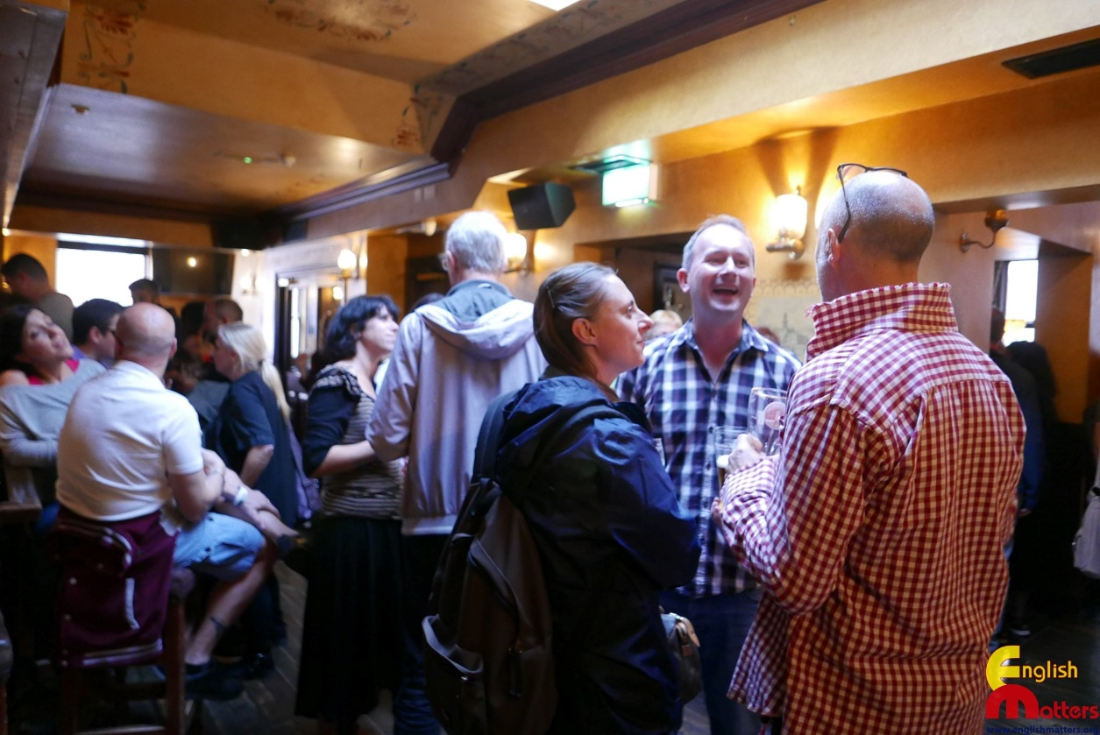
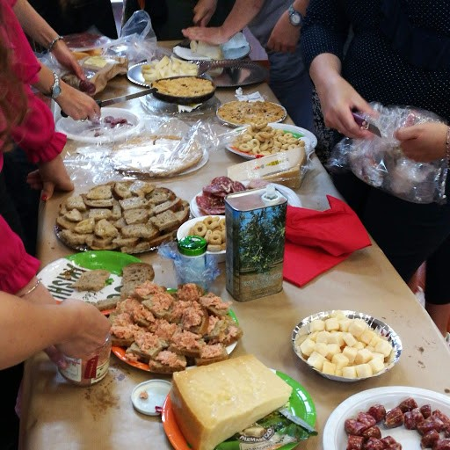
EUROPEAN DIMENSION:
FAREWELL AND NETWORKING
SPARE TIME AT THE PUB
A TASTE OF EUROPEAN FOOD

Slide 7
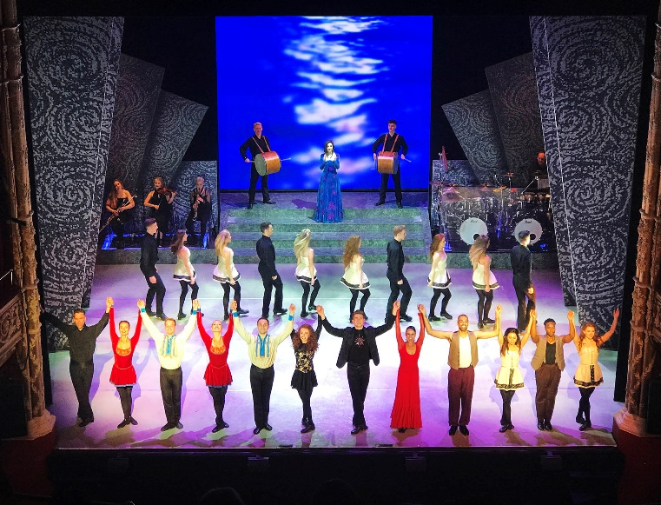
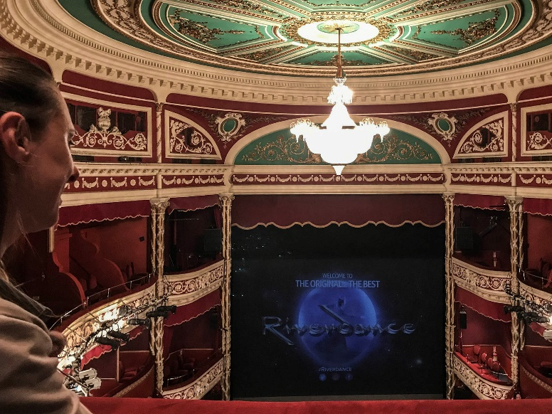
CULTURAL ASPECTS
THE GUINNESS STORE
AT THE THEATRE

Slide 8
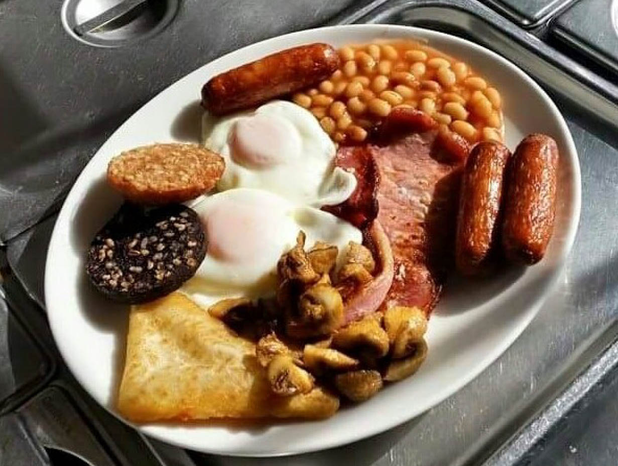
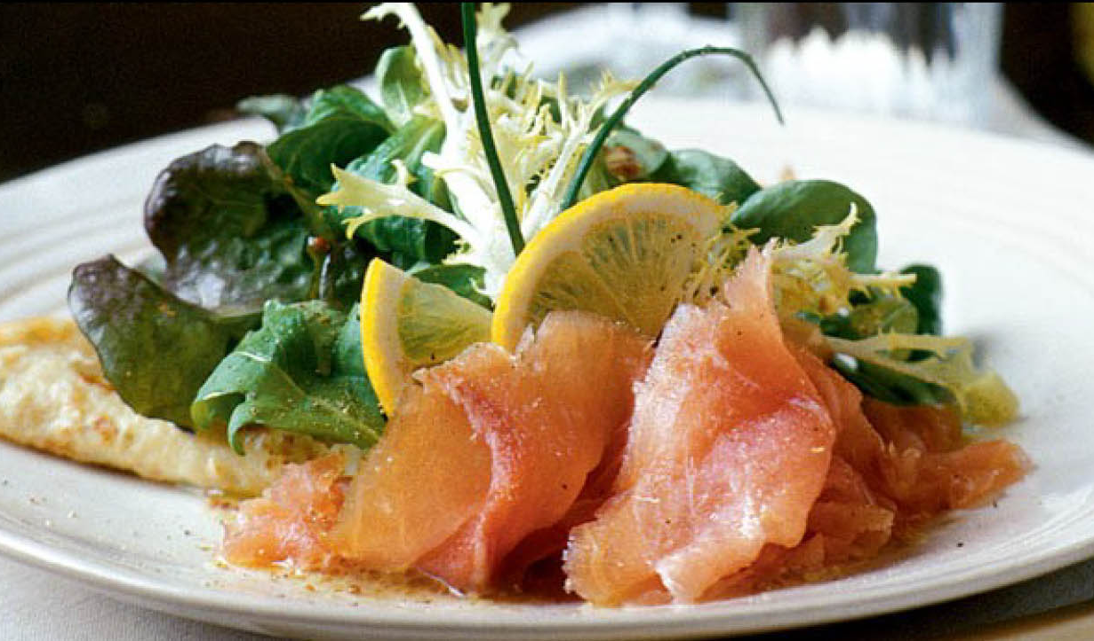
IRISH FOOD
COLCANNON
IRISH BREAKFAST
SMOKED SALMON

Slide 9
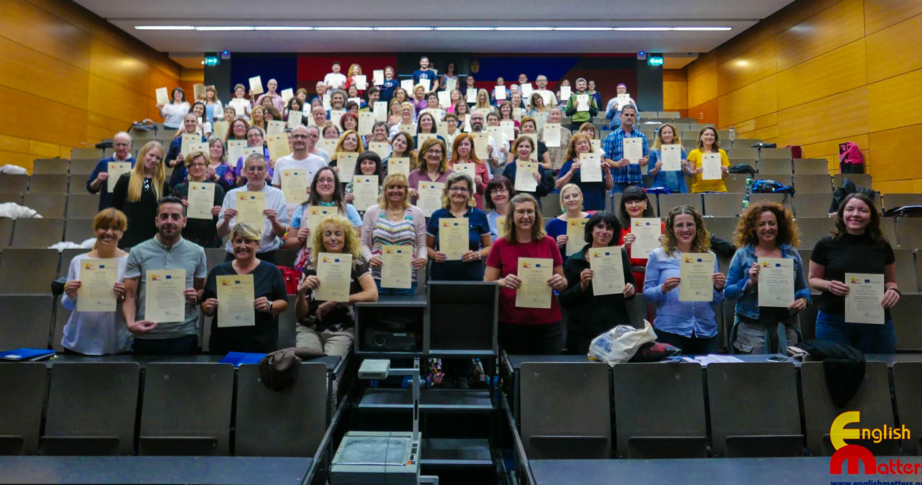
THE FINAL EXAM
AFTER TWO WEEKS OF HARD WORK
WE GOT THE CERTIFICATE

Slide 10
ERASMUS+ 2019
ISTITUTO TECNICO AGRARIO STATALE A. TOSI
CODOGNO (LO) – ITALY
TEACHERS:
FIORANI A.
LOCATELLI S.
LUPI O.
RIBOLDI V.
SCHIANO LOMORIELLO V.

